Slide 1

Sanjivani College of Engineering, Kopargaon-423603
Sanjivani Rural Education Society’s
(An Autonomous Institute Affiliated to Savitribai Phule Pune University, Pune)
NAAC ‘A’ Grade Accredited
Department of Information Technology
(UG program, NBA Accredited)
PCIT210-SOFTWEAR MODELING AND DESIGNING
Presentation on
“Fertilizer Recommendation System”
Presented by:
Guided By
Prof S.N.Gunjal
1 . Shivam Dhokane (0124UITM1131)
2 . Rutuja Dhumal (0124UITF1132)
3 . Raviraj Pawar (0124UITM1134)

Slide 2


Content
Introduction
What is UML?
Use Case Diagram
Activity Diagram
Class Diagram
Sequence Diagram
State Diagram
Component Diagram
Deployment Diagram
System Requirements
Conclusion
SEMD– CIA PART B Presentation

Slide 3

Introduction
A Fertilizer Recommendation System is a software application designed to suggest the most suitable fertilizers for crops based on soil nutrients, crop type, and environmental conditions.
Traditionally, farmers rely on guesswork or general advice, which can lead to overuse or improper use of fertilizers. This system provides a data-driven and intelligent solution.
Purpose of the system:
Provide accurate fertilizer recommendations
Improve crop yield and soil health
Reduce excessive fertilizer usage
Support farmers with smart decision-making
Promote sustainable agriculture
SEMD– CIA PART B Presentation

Slide 4

System Requirement
Functional Requirements
User inputs soil nutrient values
System analyzes soil data
User selects crop type
System generates fertilizer recommendation
Display result to user
Admin manages fertilizer database
Basic recommendations available without internet
Farmers can provide feedback on recommendation effectiveness
Sends alerts or suggestions via SMS/app notifications
Non-Functional Requirements
Security: Protect user data.
Performance: Fast response time
Reliability: Accurate recommendations
Usability: Easy interface for farmers
Scalability: Handle multiple users
SEMD– CIA PART B Presentation

Slide 5

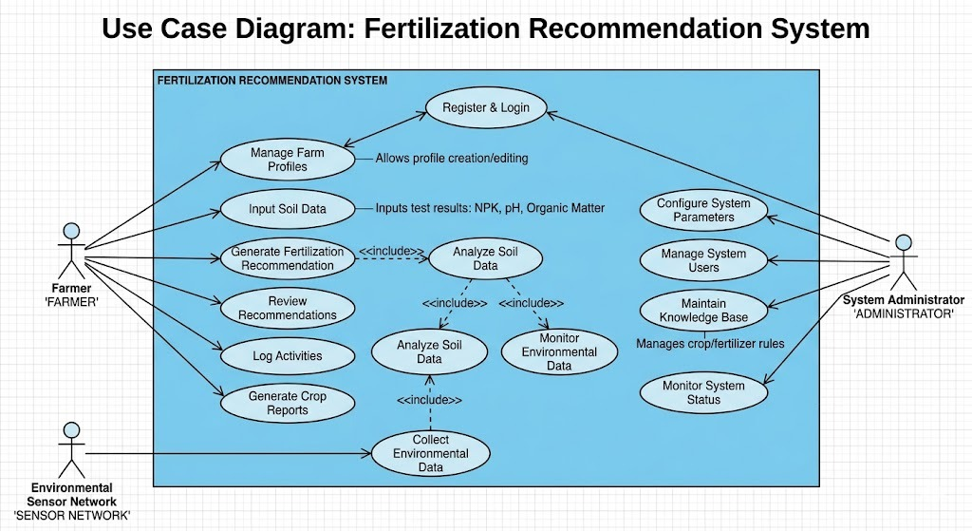
Use Case Diagram
A Use Case Diagram represents the interaction between users (actors) and the system.
Use Case Diagram Contains:
Actors : Farmer, Admin
Use Cases : (Enter soil data , select crop , View results , Manage database (Admin))
System Boundary
Associations
Include / Extend relationship
Purpose: Shows functional requirements and how users interact with the system..
SEMD– CIA PART B Presentation

Slide 6

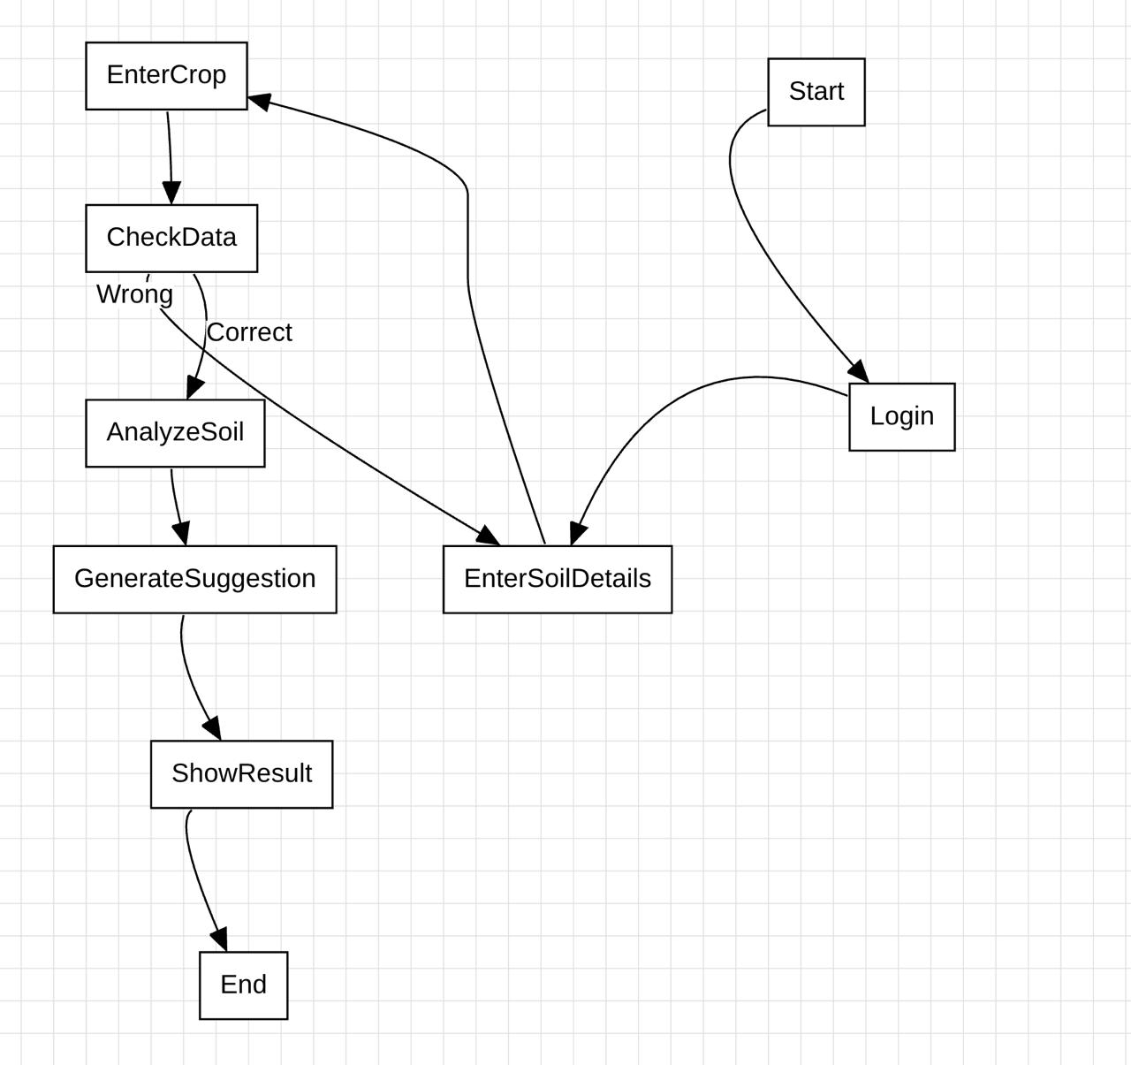
Activity Diagram
Activity Diagram shows the flow of activities in the system.
Activity Diagram Contains:
Flow :
Start → Enter Soil Data → Select Crop → Analyze Data → Generate Recommendation → Display Result → End
Purpose: Shows step-by-step working of the system.
SEMD– CIA PART B Presentation

Slide 7

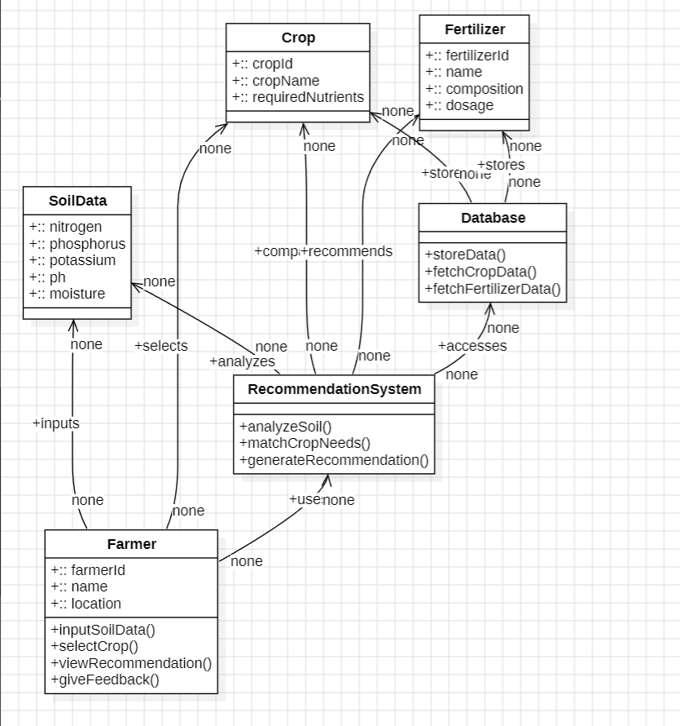
Class Diagram
Class Diagram represents system structure using classes,
attributes, methods, and relationships.
Class Diagram Contains:
Classes ( Farmers , Soil data , Crop , Fertilizer , Recommendation System)
Attributes (Soil , Crop , Fertilizer)
Methods (analyzeSoil() , recommendationFertillizer() , displayResult() )
Purpose: Shows structure and relationships between system components.
SEMD– CIA PART B Presentation

Slide 8
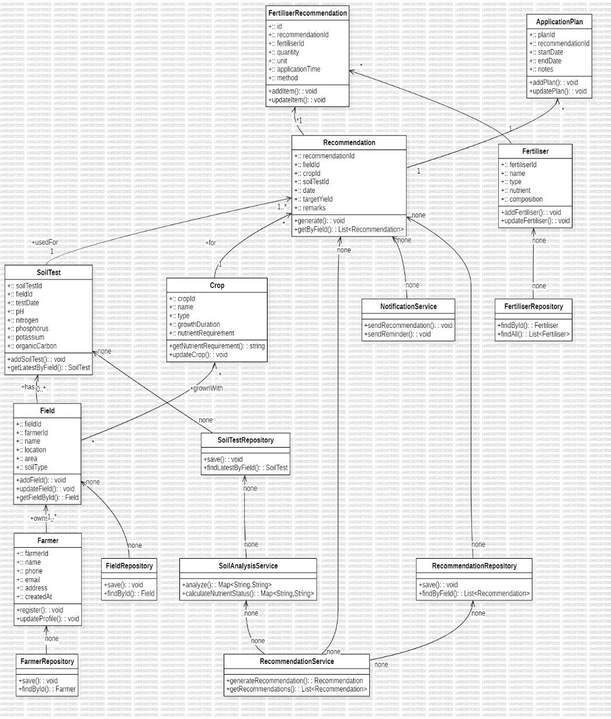
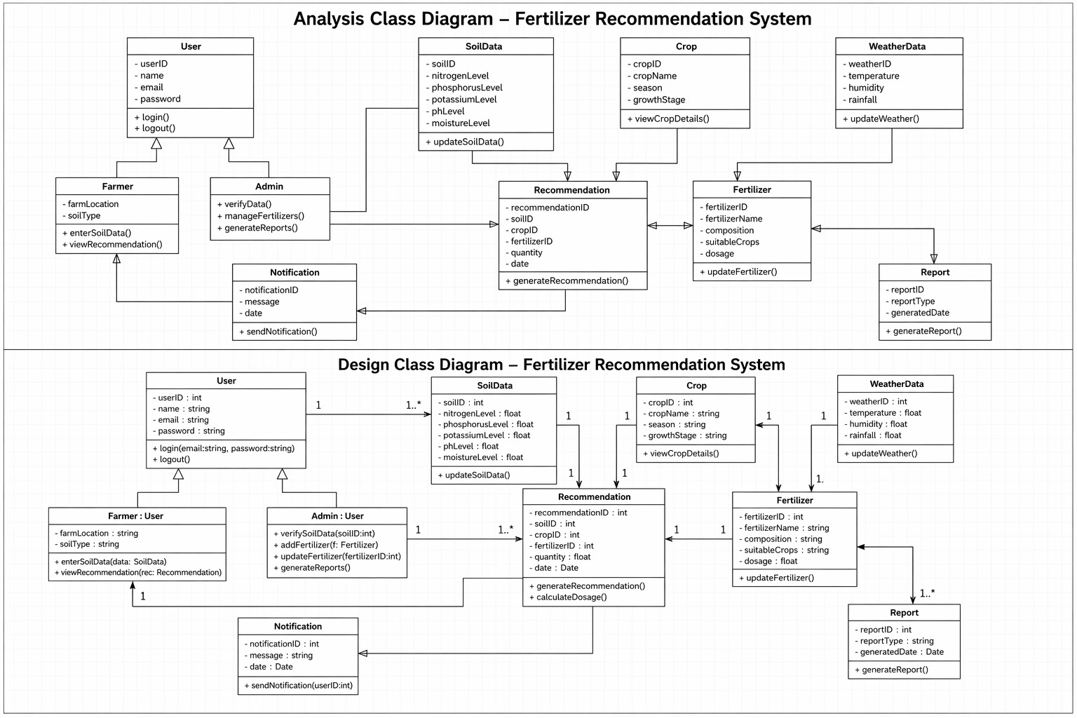
Class Diagram :

Slide 9

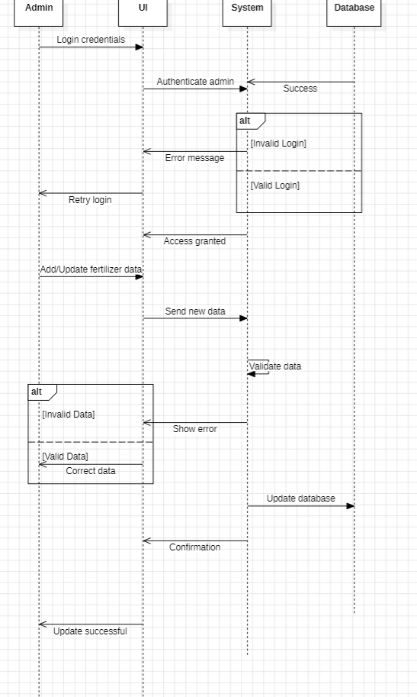
Sequence Diagram
A Sequence Diagram shows the interaction between objects in a system in a time sequence.
Sequence Diagram Contains:
Objects (Farmer , System, Database)
Messages (Input soil data , Process data , Fetch fertilizer info , Display recommendation)
Purpose:Shows communication between components step-by-step.
SEMD– CIA PART B Presentation

Slide 10
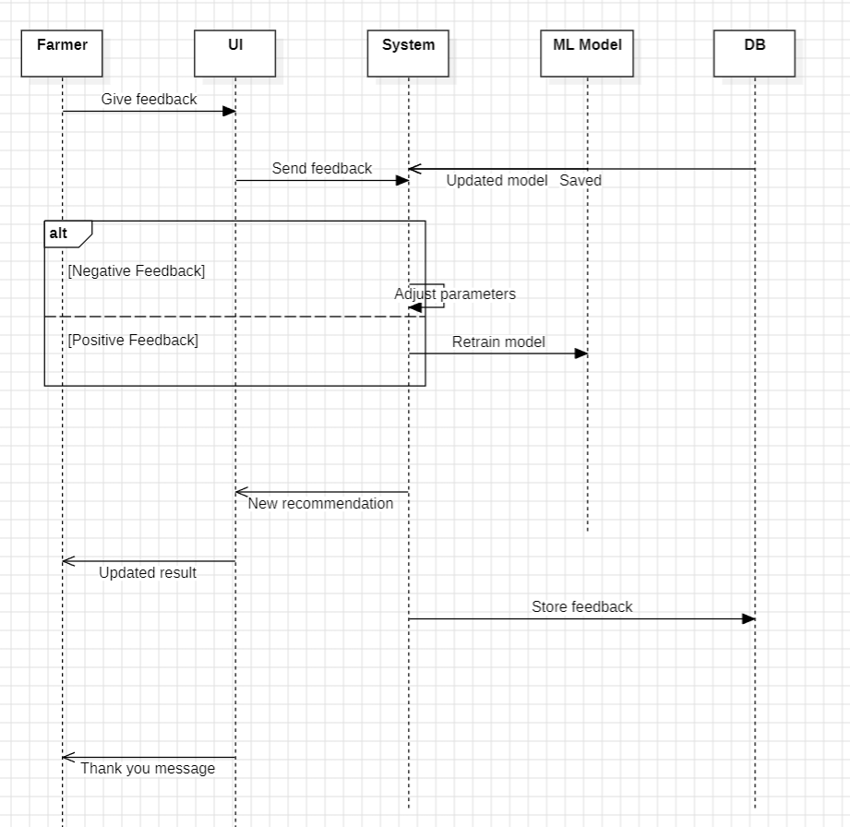
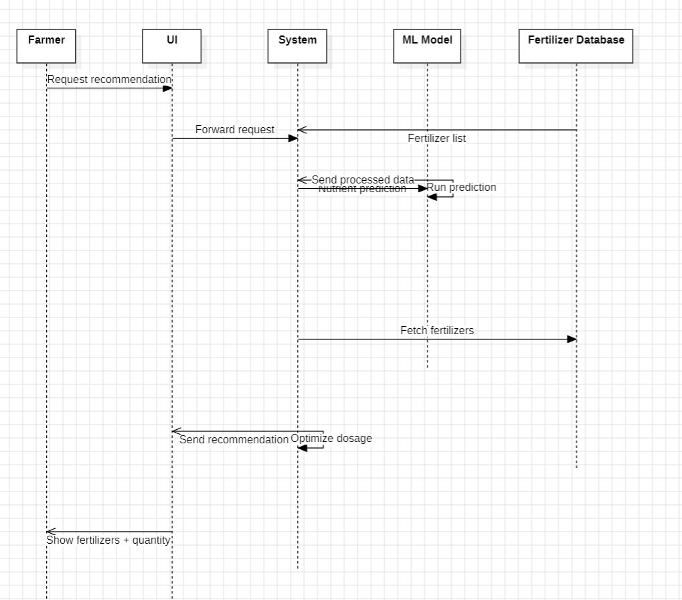
Sequence Diagram :

Slide 11
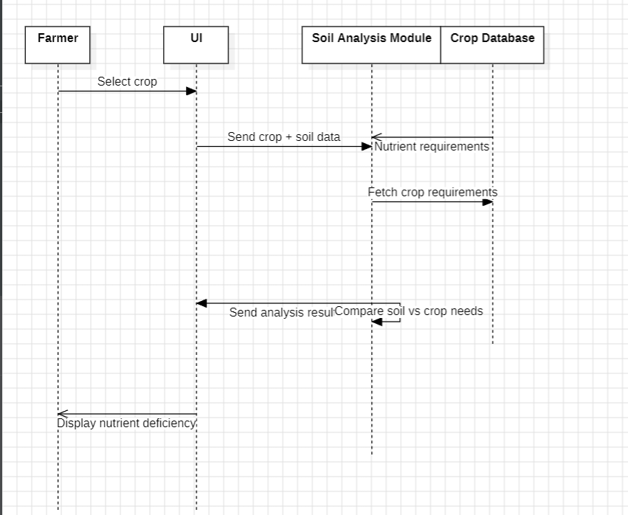
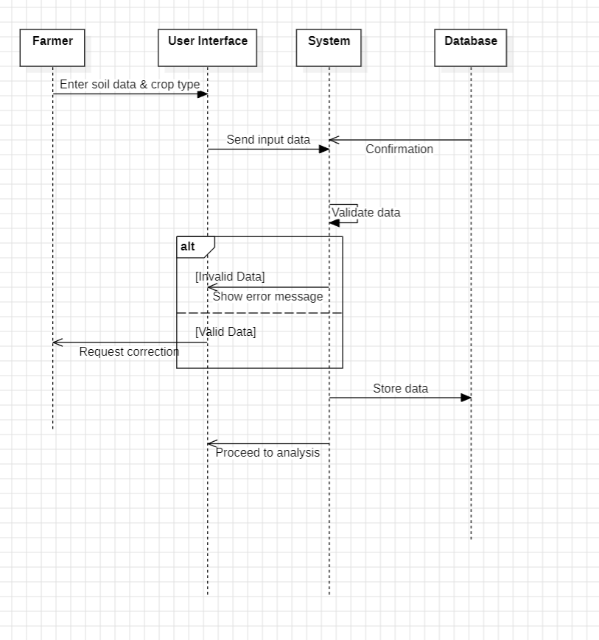
Sequence Diagram :

Slide 12

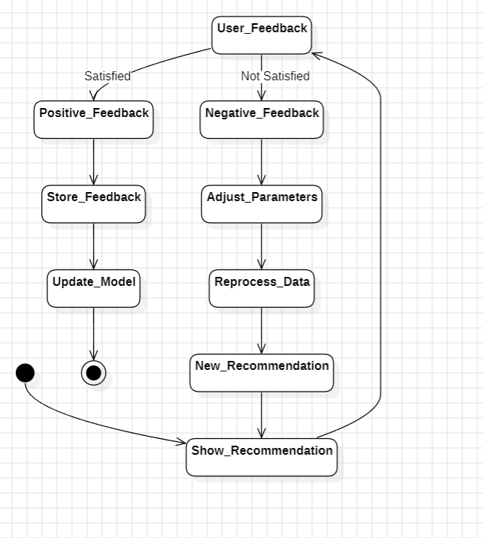
State Diagram
A State Diagram shows different states of an object and
transitions from one state to another.
State Diagram Contains:
Initial State (Start)
States (start , input received , processing , recommendation generated , displayed , end )
Transitions (Movement from one state to another based on events )
Events (Triggers for state change)
Final State (End)
Purpose: Shows system behavior and state changes.
SEMD– CIA PART B Presentation

Slide 13
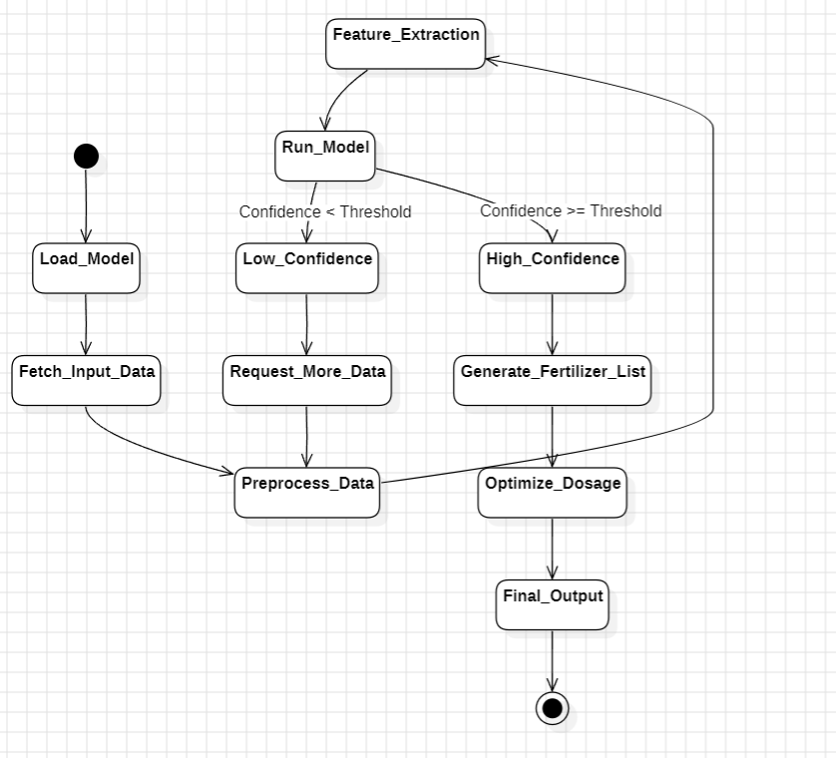
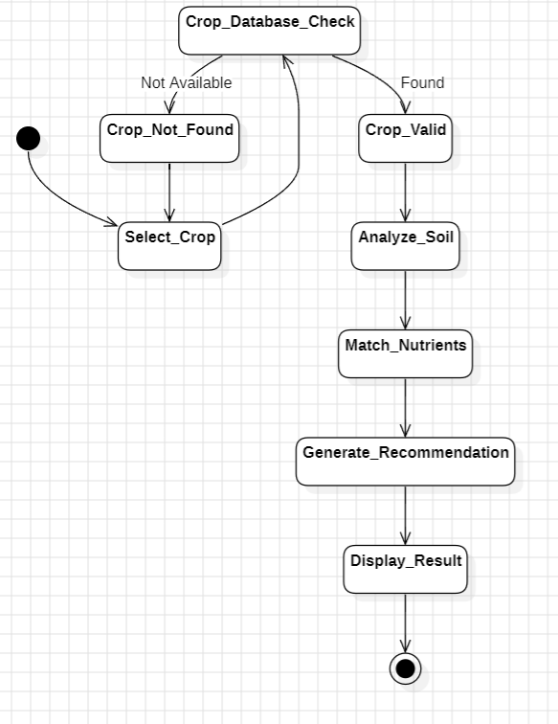
State Diagram :

Slide 14
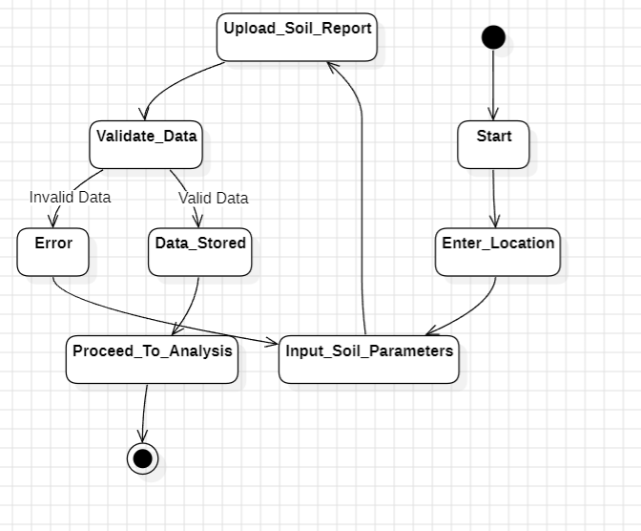
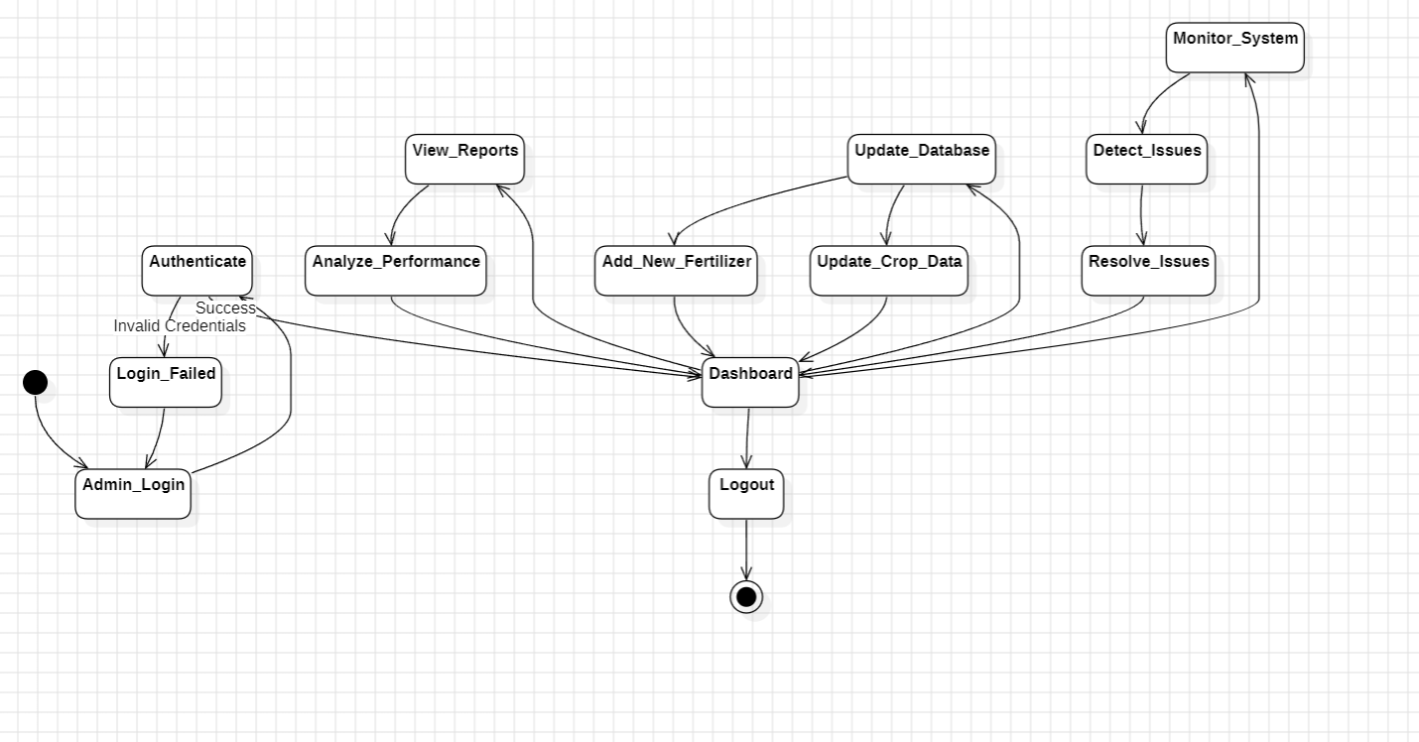
State Diagram :

Slide 15

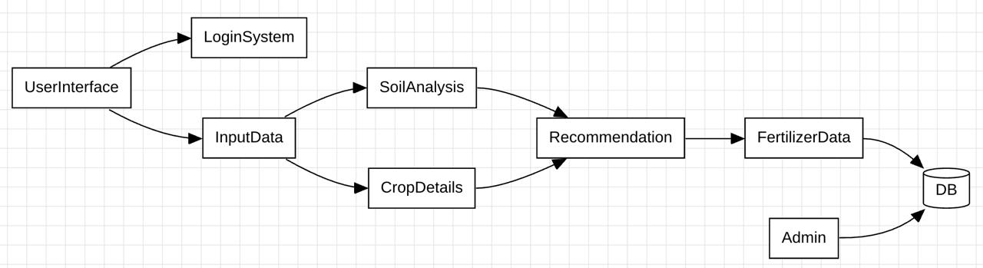
Component Diagram
A Component Diagram shows the software components of
a system and their relationships.
Component Diagram Contains:
User Interface
Data processing module
Recommendation Engine
Database
Purpose: Shows system architecture and organization.
SEMD– CIA PART B Presentation

Slide 16

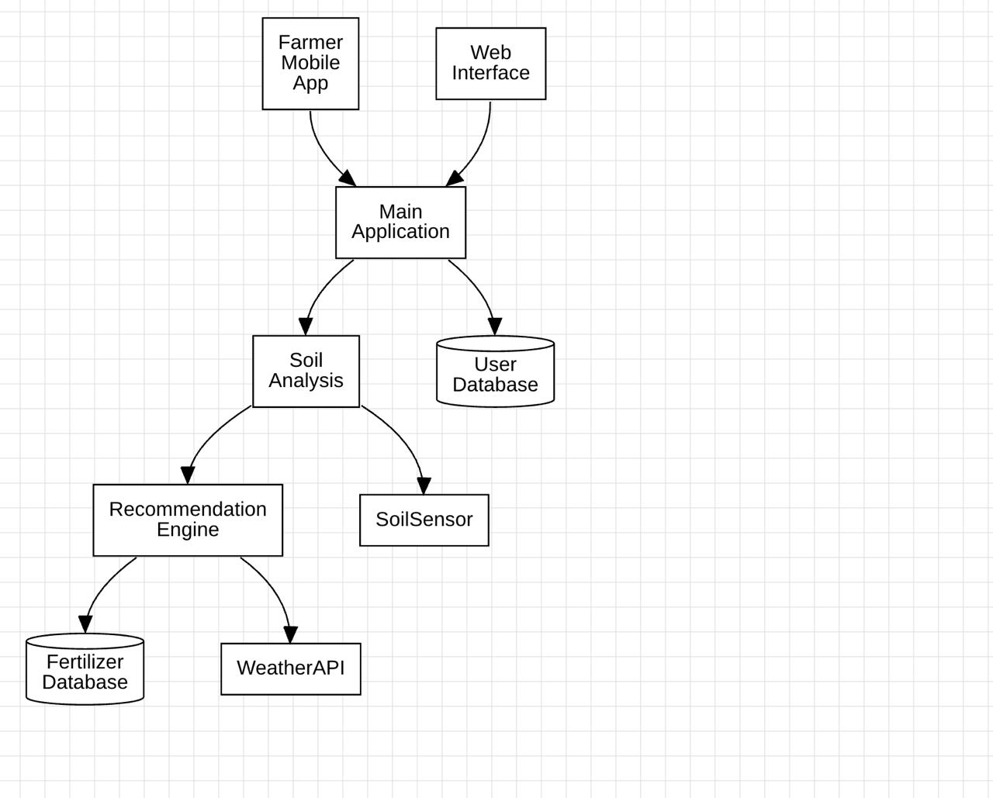
Deployment Diagram
A Deployment Diagram shows the physical deployment of hardware and software in a system.
Deployment Diagram Contains:
Nodes (User Device , Server, Database Server)
Artifacts (Software files/applications)
Communication Paths (Connections between nodes)
Deployment Relationships (Software deployed on hardware)
Execution Environment (Operating platform)
Purpose: Shows how system is deployed on hardware.
SEMD– CIA PART B Presentation

Slide 17
Data Flow Diagram :

Slide 18

Conclusion
Fertilizer Recommendation System:
Helps farmers make better decisions
Improves crop productivity
Reduces environmental damage
Promotes efficient fertilizer usage.
UML diagrams help in proper system design and development
SEMD– CIA PART B Presentation

Slide 19
Thank You…
SEMD– CIA PART B Presentation

